Slide 1
California Department of Housing and Community Development
Planning and Conservation League
January 25, 2020
Craig Shields

Slide 2
HCD’s State-Funded Multifamily Permanent Lending Programs
Access to Opportunity | Homelessness | Climate Programs
Multifamily Housing (MHP) Joe Serna, Jr. Farmworker Housing (Serna) | No Place Like Home (NPLH) Veterans Housing and Homelessness Prevention (VHHP) | Affordable Housing and Sustainable Communities (AHSC) Infill Infrastructure Grant (IIG) Transit-Oriented Development (TOD)
Notes:
The Department’s Division of Financial Assistance has organized our state funding programs into three policy priority areas: Access to Opportunity – is a suite of programs that fund a wide range of project types from large family apartments to housing for people who put the food on our tables.
Homelessness – includes two housing first programs that strive to reconnect people experiencing homelessness with safe, affordable homes and supportive services.
Climate Change – those are housing and infrastructure funding programs that consider the nexus between climate change and affordable housing.

Slide 3
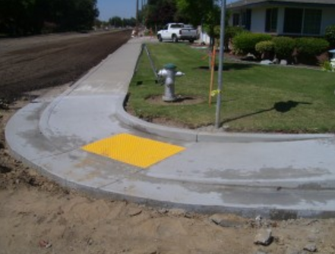
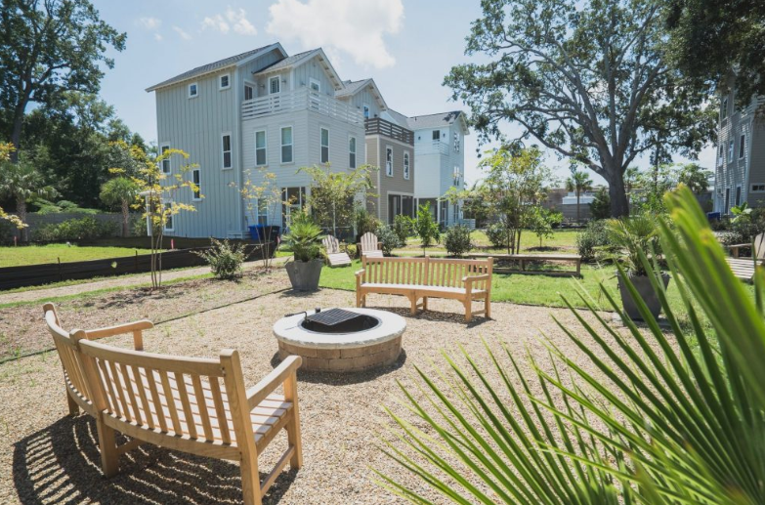
Infill Infrastructure Grant Program Infrastructure
Parks
Utility improvements
Streets
Sidewalks & bike lanes
Traffic signals
Site preparation
Streetscape improvements
Storm drains
Notes:
Last summer, Governor Newsom signed AB 101, the housing and homelessness budget trailer bill, which authorized $500 million to support infill housing development.
The Infill Infrastructure Grant program serves to aid in new construction and rehabilitation of infrastructure that supports higher-density affordable and mixed-income housing, on sites designated as infill.
Unlike prior iterations of the Infill Infrastructure Grant program, the version authorized by AB 101 includes a broader definition of infill that is more workable for smaller counties, as well as an $85 million over-the-counter program for counties with fewer than 250,000 residents.

Slide 4
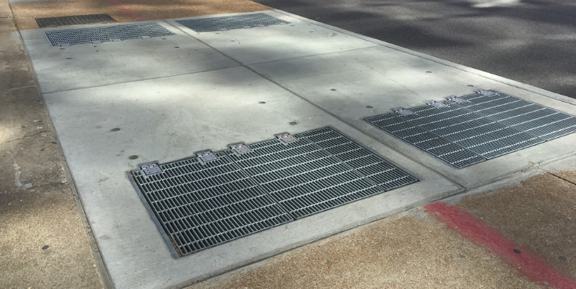
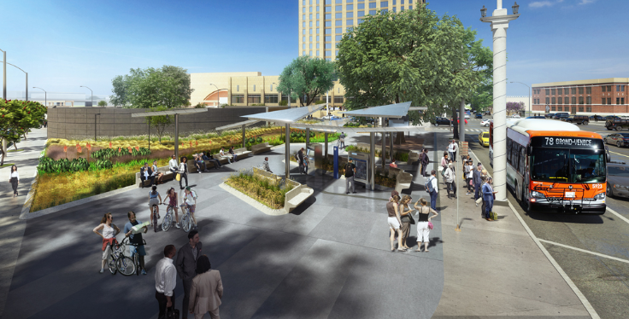
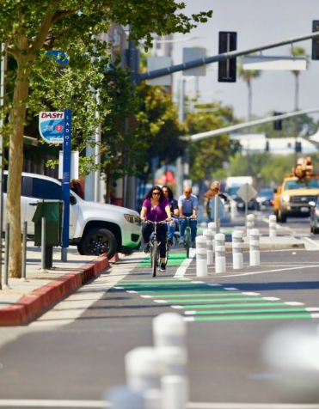
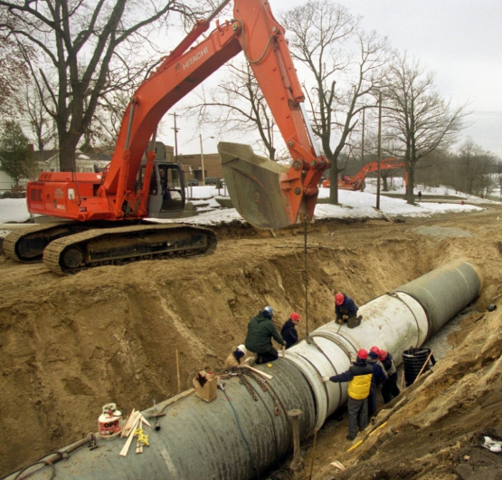
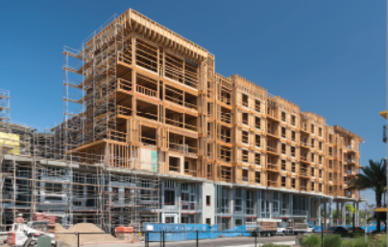
Transit-Oriented Development Program Infrastructure
Water Upgrades
Sewer Upgrades
Bike Lanes
Drainage
Utility Access
Parking Spaces or Structures
Transit Stop Improvements

Slide 5
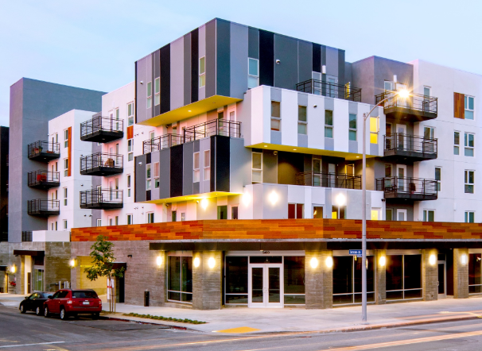
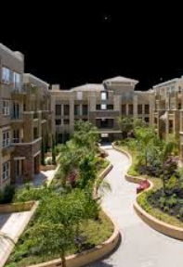
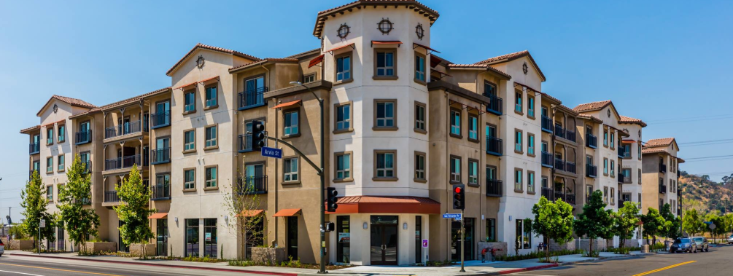
Transit-Oriented Development Program Housing
Loans for Rental Developments
Grants for Homeownership Developments

Slide 6
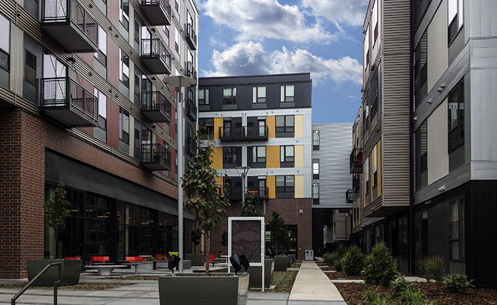
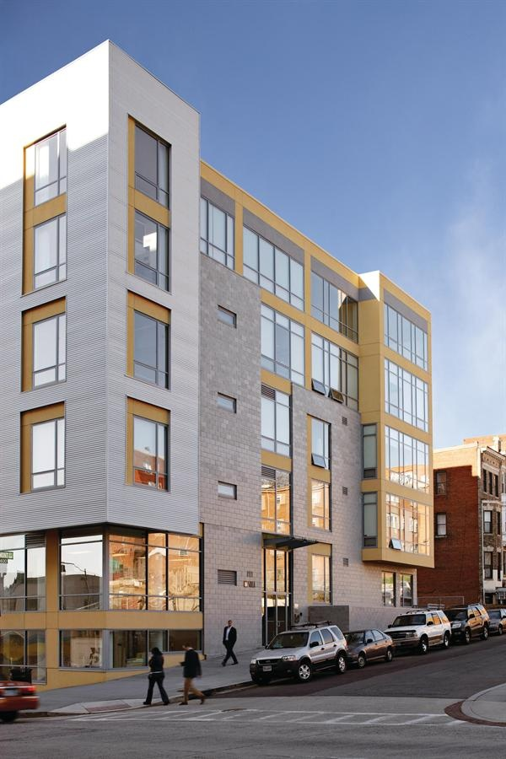
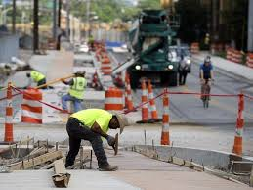
Affordable Housing and Sustainable Communities Housing and Housing-Related Infrastructure
Loans for Rental Developments
Grants for Homeownership Developments
Grants for Housing-Related Infrastructure

Slide 7
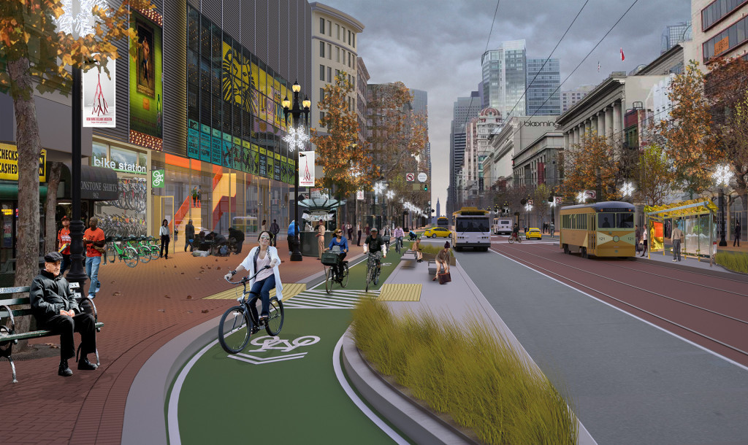
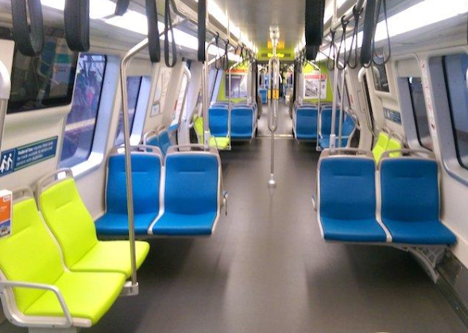
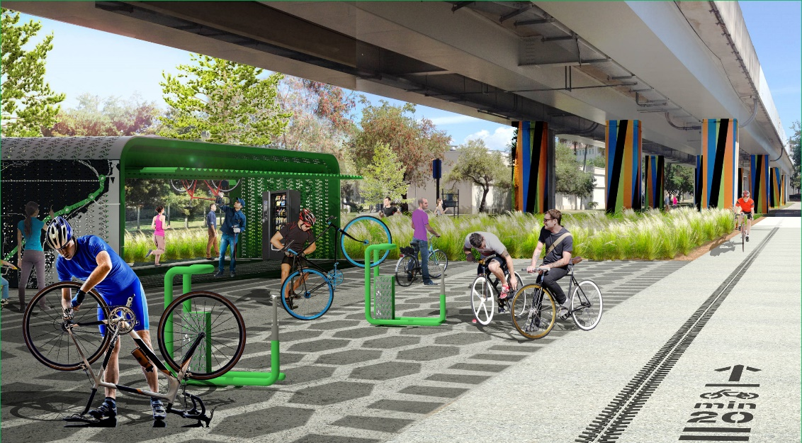
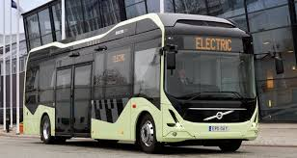
Affordable Housing and Sustainable Communities Transportation Infrastructure and Amenities
Sidewalks
Bikeways
Traffic Calming Enhancements
Traffic Control Devices
Secure Bike Parking
Busses, Ferries, Train Cars

Slide 8
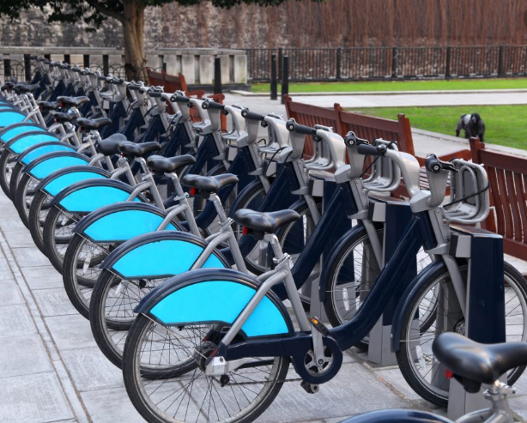
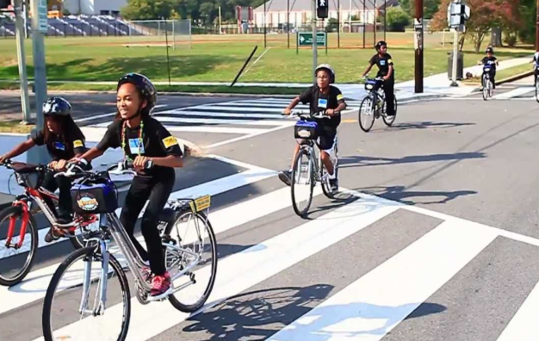
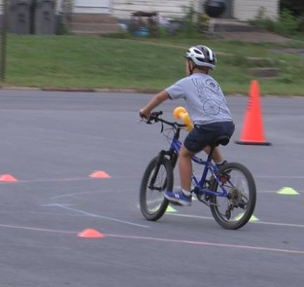
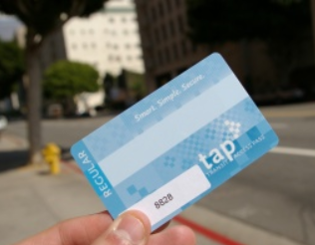
Affordable Housing and Sustainable Communities Programs
Bike Safety
Walking School Bus
Bike Share
Transit Subsidy
Public Outreach

Slide 9
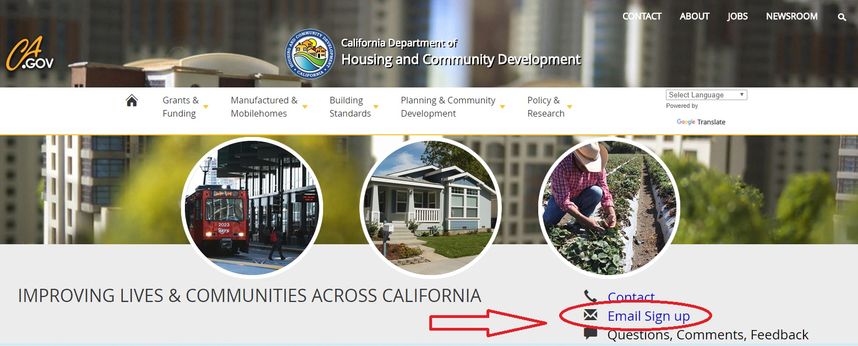
Sign up for HCD email:
www.hcd.ca.gov

Slide 10
Stay in the know . . . Follow HCD on social media
Like us on Facebook: /CaliforniaHCD
Follow us on Twitter: @California_HCD
Follow us on LinkedIn: /company/californiahcd
Notes:
Follow us on a variety of social media to hear about our events and accomplishments

